Slide 1
Exam 1
AERO 4720 Aircraft Design II

Slide 2
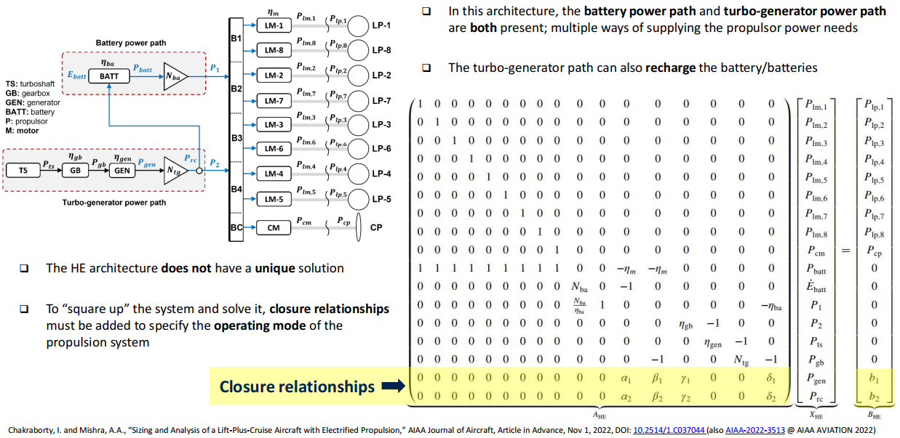
Hybrid-Electric Propulsion – Power Flow Relationships

Slide 3
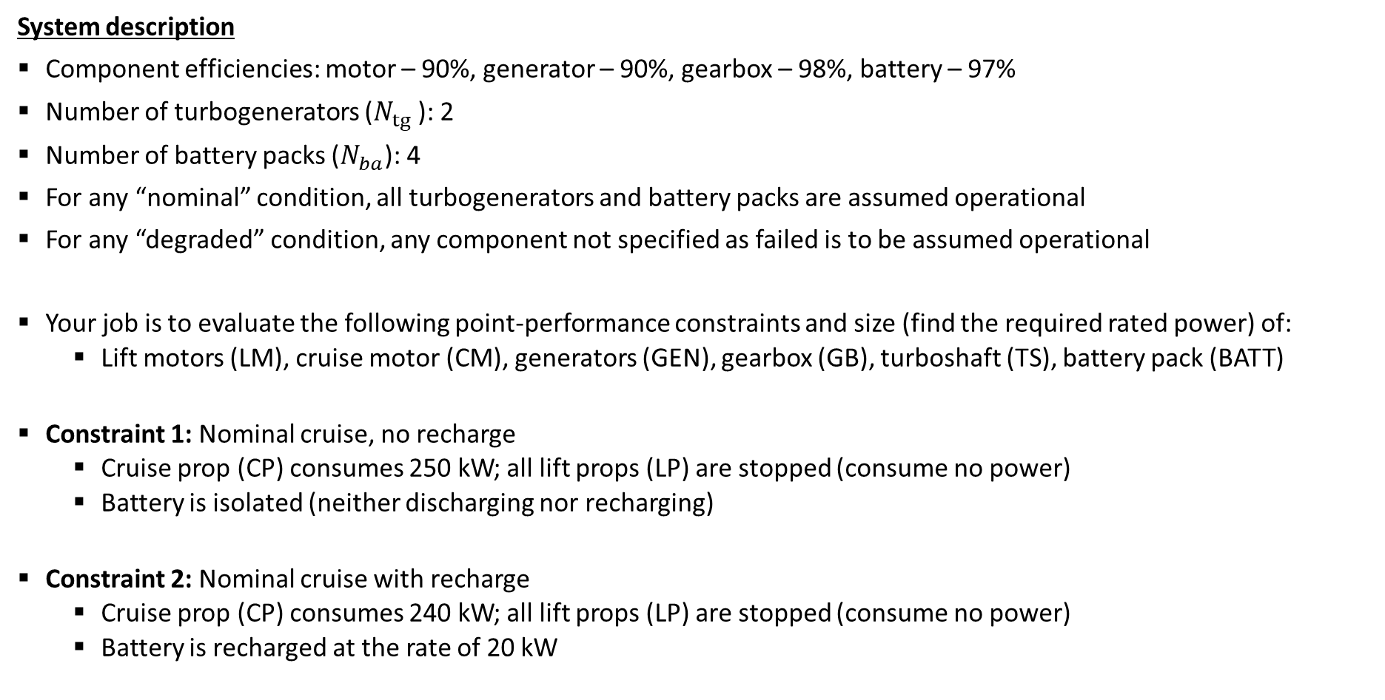
Problem 1
System description
Component efficiencies: motor – 90%, generator – 90%, gearbox – 98%, battery – 97%
Number of turbogenerators ($N_{tg}⁡$): 2
Number of battery packs ($N_{ba}$): 4
For any “nominal” condition, all turbogenerators and battery packs are assumed operational
For any “degraded” condition, any component not specified as failed is to be assumed operational
Your job is to evaluate the following point-performance constraints and size (find the required rated power) of:
  Lift motors (LM), cruise motor (CM), generators (GEN), gearbox (GB), turboshaft (TS), battery pack (BATT)
Constraint 1: Nominal cruise, no recharge
  Cruise prop (CP) consumes 250 kW; all lift props (LP) are stopped (consume no power)
  Battery is isolated (neither discharging nor recharging)
Constraint 2: Nominal cruise with recharge
  Cruise prop (CP) consumes 240 kW; all lift props (LP) are stopped (consume no power)
  Battery is recharged at the rate of 20 kW

Slide 4
Problem 1
Constraint 3: Degraded cruise
  One turbogenerator has failed, the aircraft is limping home at reduced speed
  Cruise prop consumes 180 kW; all lift props are stopped (consume no power)
  Battery is isolated (neither discharging nor recharging)
Action: Since the turbo-shaft engines are sized based on cruise conditions (nominal or degraded), evaluate Constraints 1, 2, and 3, determine the rated power of the turbo-shaft engines (TS).
Constraint 4: Nominal hover
  Each lift prop (LP) consumes 75 kW, cruise prop (CP) is inactive
  Both turboshaft engines (TS) are operating at their rated power
  Battery power path supplies the remaining power
Constraint 5: Degraded hover, 1 turbo-shaft failed
  Each lift prop (LP) consumes 75 kW, cruise prop (CP) is inactive
  One turbo-shaft failed; the other one operates at its rated power
  Battery power path supplies the remaining power requirement

Slide 5
Problem 1
Constraint 6: Degraded hover, 1 battery pack failed
  Each lift prop (LP) consumes 75 kW, cruise prop (CP) is inactive
  Both turboshaft engines (TS) are operating at their rated power
  Battery power path supplies the remaining power, but with one battery pack failed
Constraint 7: Degraded hover, two LP’s inoperative
  Assume LP-1 has failed and diagonally opposite LP-8 has been shut down for moment balance
  Remaining LPs each consume 133 kW
  Both turboshaft engines (TS) are operating at their rated power
  Battery power path supplies the remaining power requirement

Slide 6
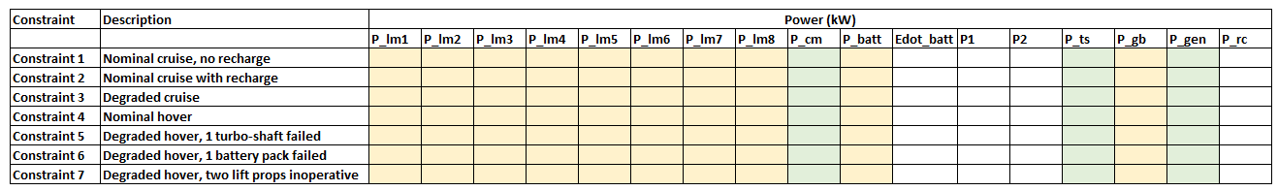
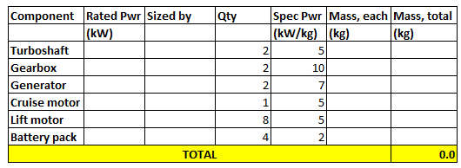
Problem 1
Capture the solutions of each constraint in the spreadsheet that will be provided
  Points: 10 points for each constraint
Use the rated power of each component and provided specific power (kW/kg) to estimate propulsion system mass
  Points:
    10 for correctly identifying the constraint that sizes each component (e.g., constraint 1, etc.)
    10 for correct computation of component masses
    10 for correct computation of total system mass

